Slide 1
Predicting Lethality of Car Crashes in New York City Boroughs
Aaryan Sumesh, Sami Saleh

Slide 2
Background and Project Goal
Growing City Complexity: As NYC's traffic conditions become more complex, understanding road incidents is crucial.
Safety Insights: These classifications can reveal patterns that lead to preventative measures.
We will be trying to predict the lethality of car crashes in New York City.

Slide 3
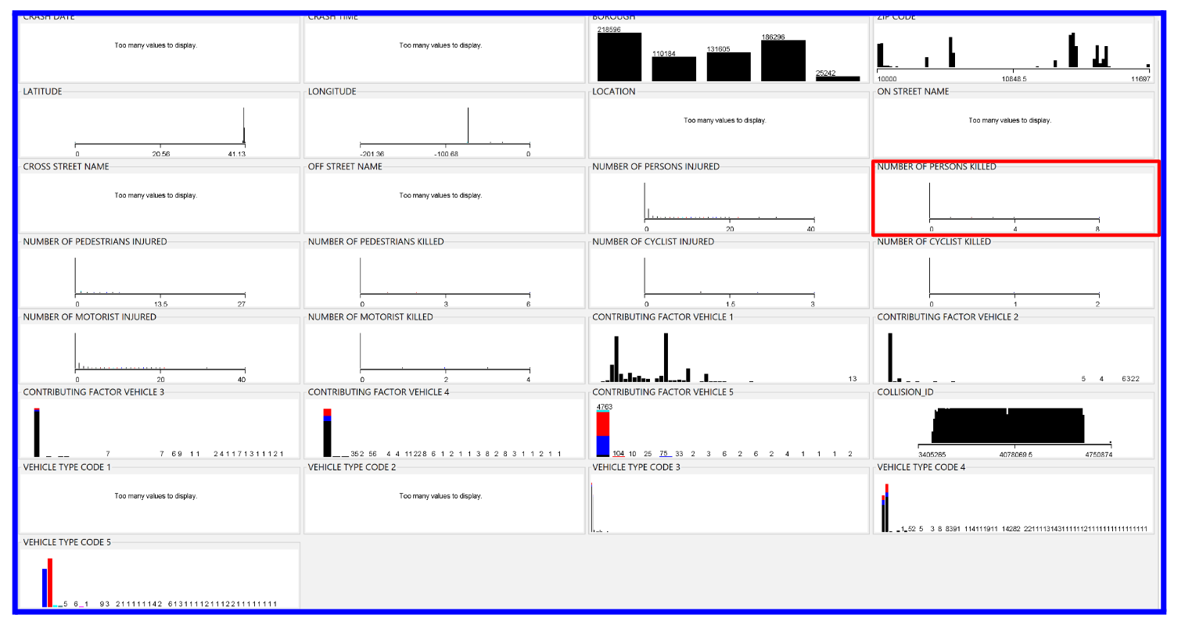
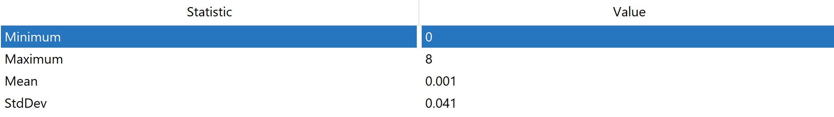
Dataset Information
Key attributes:
NUMBER OF PERSONS KILLED: Total persons killed in car accident
CONTRIBUTING FACTOR VEHICLE 1, 2, 3 …: A label of a possible reason that the driver was involved in the car accident, ex. Pavement slippery, Illegal drugs, …
VEHICLE TYPE CODE 1, 2, 3…: A label for the form of transportation of the vehicle, ex. Sedan, bike, taxi, …

Slide 4
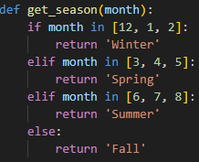
Preprocessing
Step 1: Remove all instances where class attribute is missing (RemoveWithValues)
Step 2: Remove unnecessary attributes - Collision_id
Step 3: Remove attributes with majority missing values - Cross street name, Off street name, Vehicle Type code 3, 4, 5.
Step 4: Remove redundant attributes - Number of pedestrians killed, Number of motorists killed, Number of cyclists killed, Location
Step 5: Alter crash date to Season
Crash Date
Season
10/20/2023
Fall
01/15/2023
Winter
Step 5

Slide 5
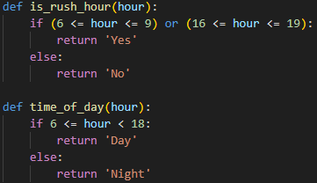
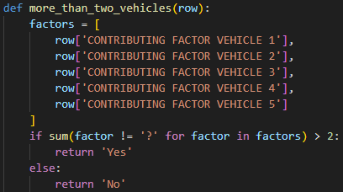
Preprocessing
Crash Time
Rush Hour
Time of Day
02:35
No
Night
Step 6: Alter crash time
Step 7: Alter contributing vehicle factors 3-5
16:07
Yes
Day
Contributing Vehicle Factors 3, 4, 5
More than two Vehicles Involved
Unspecified, ?, ?
Yes
?, ?, ?
No
Step 7
Step 6

Slide 6
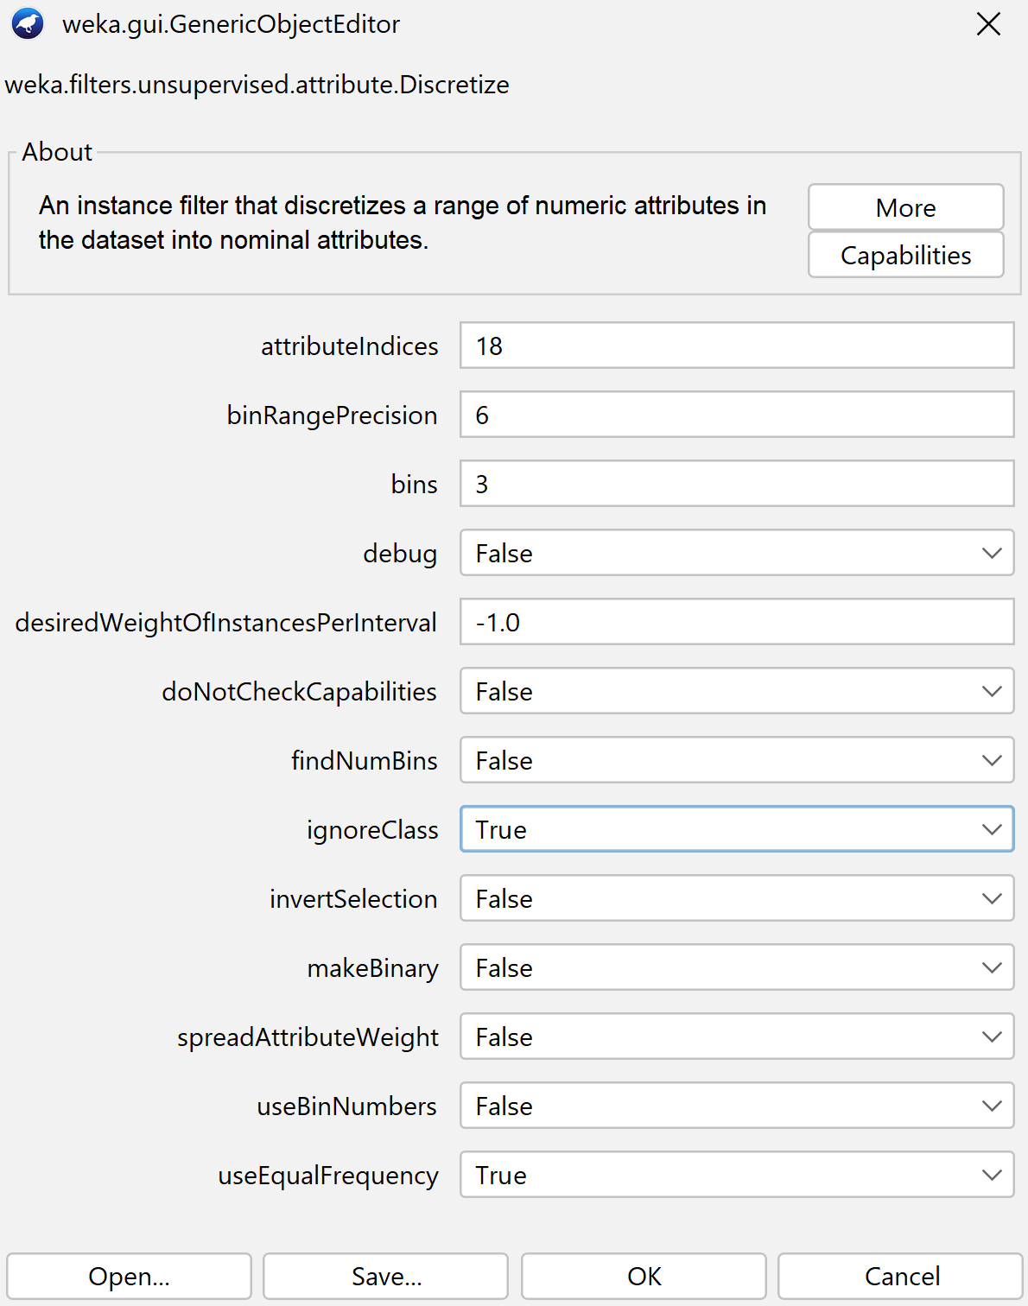
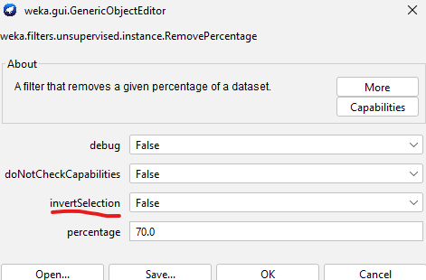
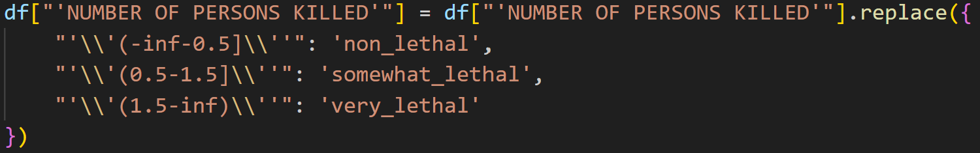
Preprocessing
Step 9
Step 8: Replace missing values - ReplaceMissingValues filter in weka
Step 9: Bin the class variable (-inf-0.5], (0.5-1.5], [1.5-inf)
Step 10: Replace bin names with better names (non_lethal, somewhat_lethal, very_lethal)
Step 11: Train Test Split (70%, 30%) - stratified random sample
Step 11
Step 10

Slide 7
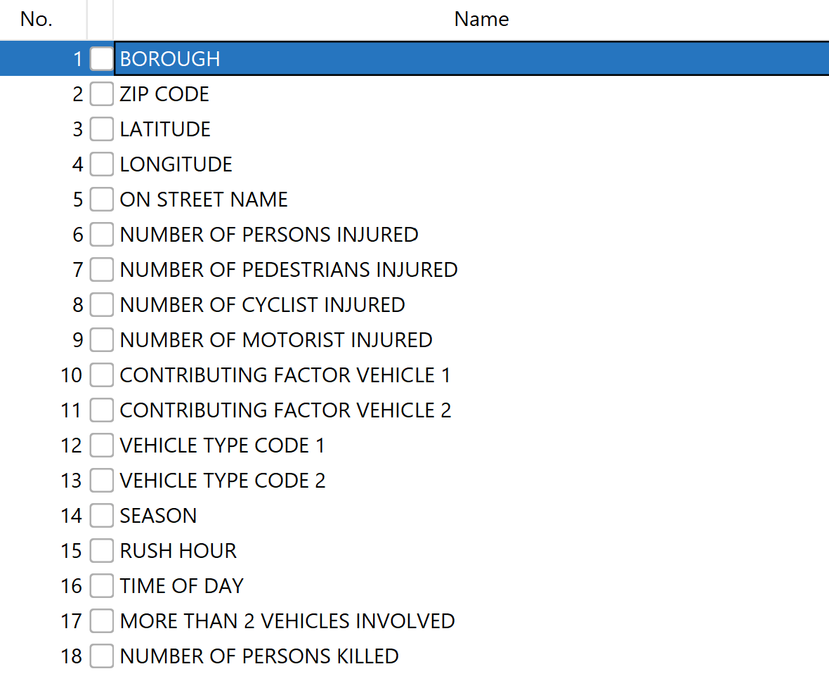
Preprocessing
No need for any Normalization

Slide 8
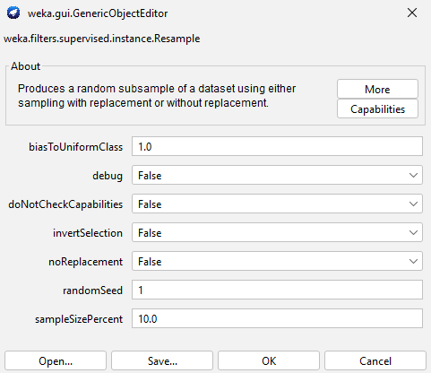
Attribute Selection Algorithms and Model Classifiers
Due to the skewed distribution in the class attribute, with 732807 instances being classified as “non_lethal”, 1131 instances being classified as “somewhat_lethal”, and 38 instances being classified as “very_lethal”, we decided to take a stratified sample of the training data for attribute selection. To do this, we used the WEKA Resample filter with a sample size percent of 10% due to the dataset being very large.
Notes:
https://medium.com/@abdallahashraf90x/oversampling-for-better-machine-learning-with-imbalanced-data-68f9b5ac2696
When working with imbalanced datasets, we are usually interested in classifying the minority classes correctly

Slide 9
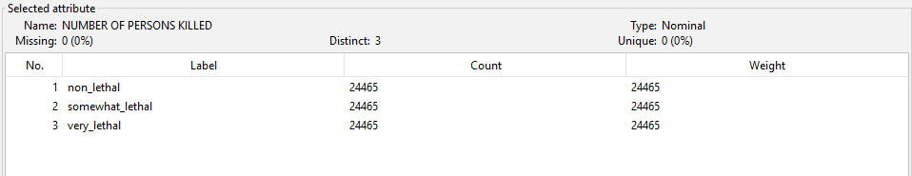
Attribute Selection Algorithms and Model Classifiers
This left us with a stratified sample of the data, with each class label having 24465 instances:

Slide 10
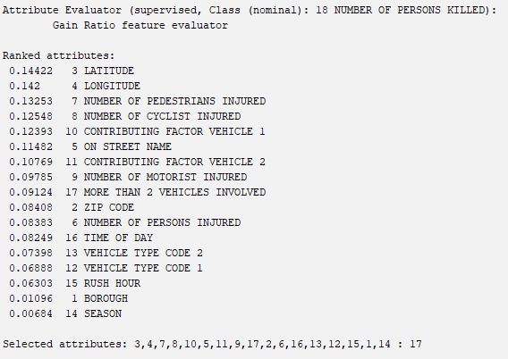
Attribute Selection Algorithms and Model Classifiers
Attribute Selection Algorithm One: GainRatioAttributeEval
Cut-off value: 0.1
Selected Attributes: LATITUDE, LONGITUDE, NUMBER OF PEDESTRIANS INJURED, NUMBER OF CYCLIST INJURED, CONTRIBUTING FACTOR VEHICLE 1, ON STREET NAME, CONTRIBUTING FACTOR VEHICLE 2

Slide 11
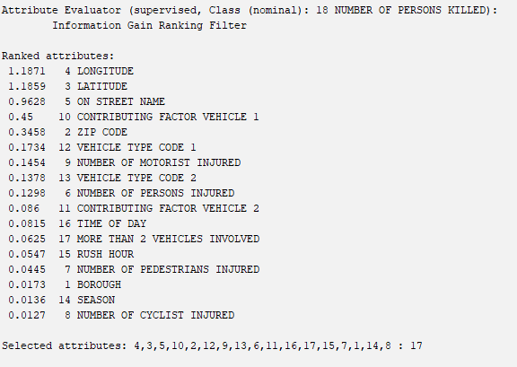
Attribute Selection Algorithms and Model Classifiers
Attribute Selection Algorithm Two: InfoGainAttributeEval
Cut-off value: 0.1
Selected Attributes: LONGITUDE, LATITUDE, ON STREET NAME, CONTRIBUTING FACTOR VEHICLE 1, ZIP CODE, VEHICLE TYPE CODE 1, NUMBER OF MOTORIST INJURED, VEHICLE TYPE CODE 2, NUMBER OF PERSONS INJURED

Slide 12
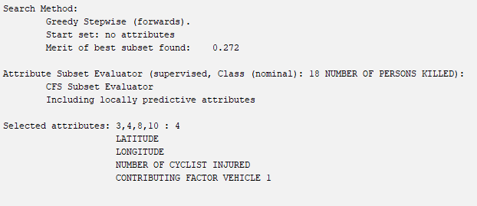
Attribute Selection Algorithms and Model Classifiers
Attribute Selection Algorithm Three: CfsSubsetEval w/ Greedy Stepwise Approach
Selected Attributes: LATITUDE, LONGITUDE, NUMBER OF CYCLIST INJURED, CONTRIBUTING FACTOR VEHICLE 1

Slide 13
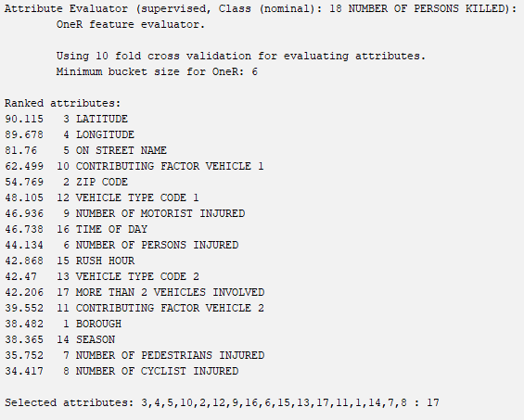
Attribute Selection Algorithms and Model Classifiers
Attribute Selection Algorithm Four: OneRAttributeEval
Cut-off value: 40%
Selected Attributes: LATITUDE, LONGITUDE, ON STREET NAME, CONTRIBUTING FACTOR VEHICLE 1, ZIP CODE, VEHICLE TYPE CODE 1, NUMBER OF MOTORIST INJURED, TIME OF DAY, NUMBER OF PERSONS INJURED, RUSH HOUR, VEHICLE TYPE CODE 2, MORE THAN 2 VEHICLES INVOLVED

Slide 14
Attribute Selection Algorithms and Model Classifiers
Attribute Selection Algorithm Five: Non-WEKA Approach
Comparing all previous attribute selection algorithms, the only two attributes that were recommended to be removed in all algorithms were SEASON and BOROUGH

Slide 15
Attribute Selection Algorithms and Model Classifiers
Models Selected for Classification:
J48
Naive Bayes
OneR
DecisionTable

Slide 16
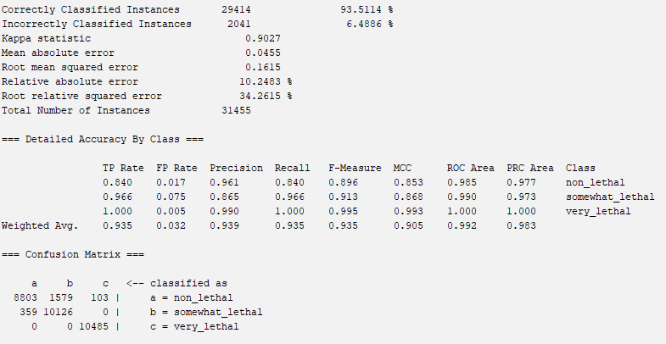
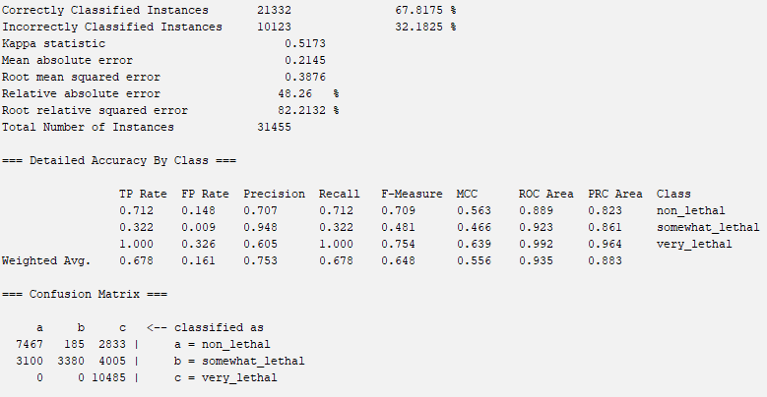
GainRatioAttributeEval
J48
Naive Bayes

Slide 17
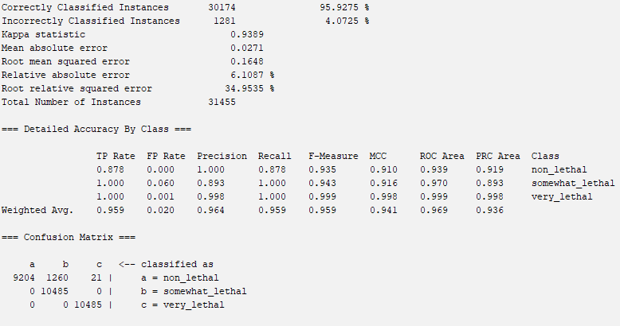
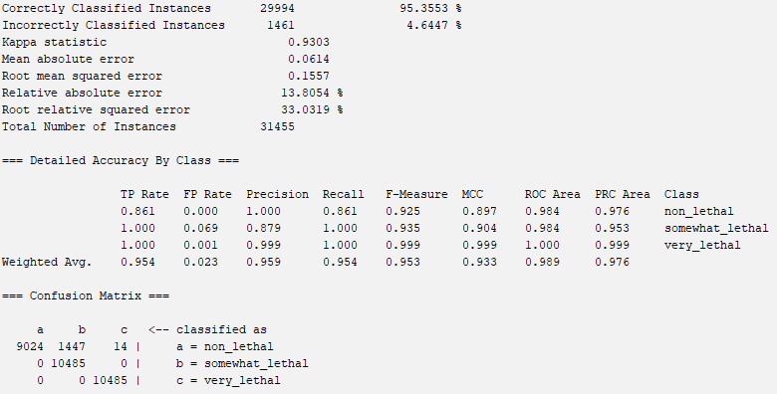
GainRatioAttributeEval
OneR
DecisionTable

Slide 18
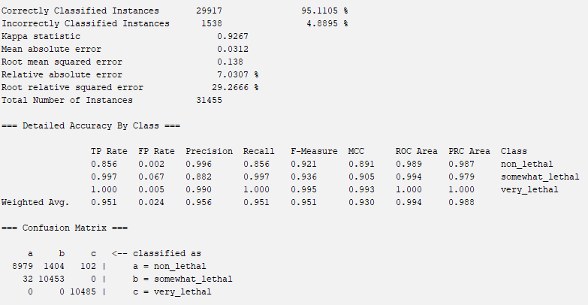
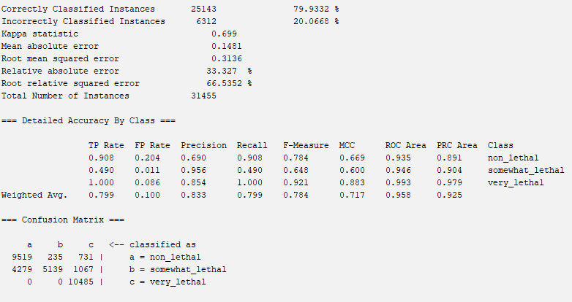
InfoGainAttributeEval
J48
Naive Bayes

Slide 19
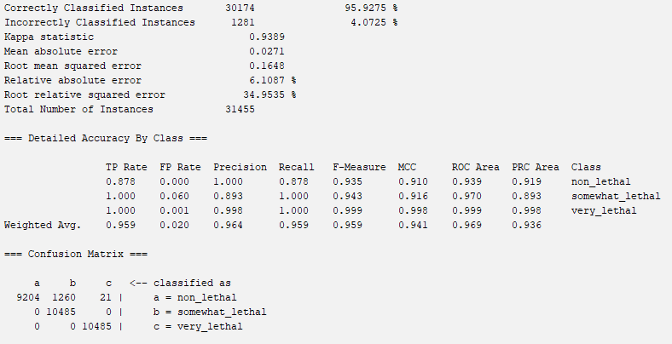
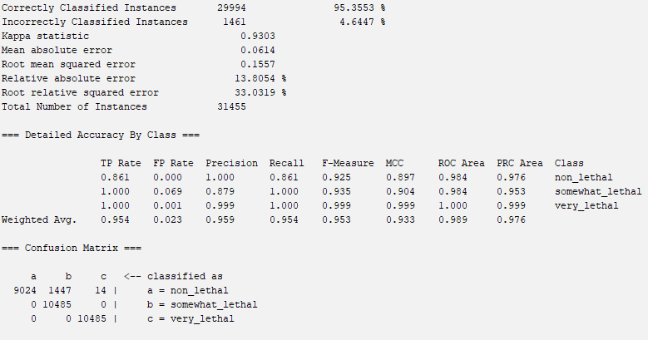
InfoGainAttributeEval
OneR
Decision Table

Slide 20
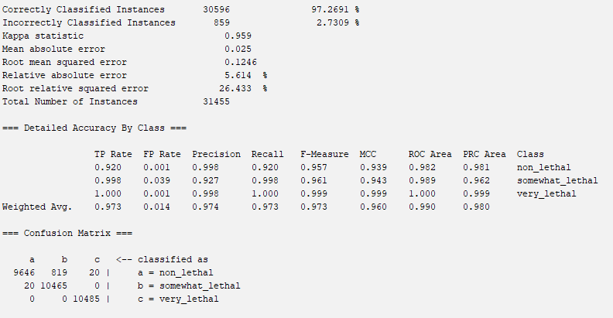
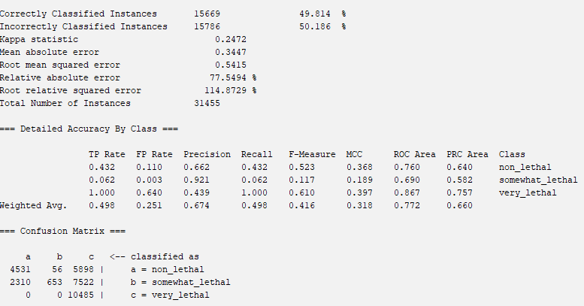
CfsSubsetEval with Greedy Stepwise Search Method
J48
Naive Bayes

Slide 21
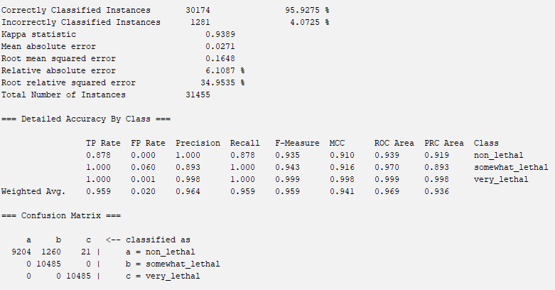
CfsSubsetEval with Greedy Stepwise Search Method
OneR
Decision Table

Slide 22
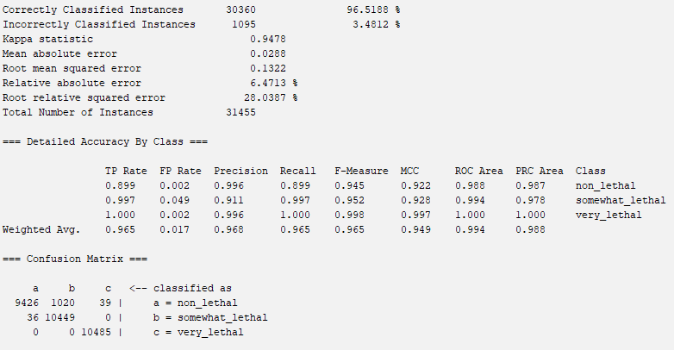
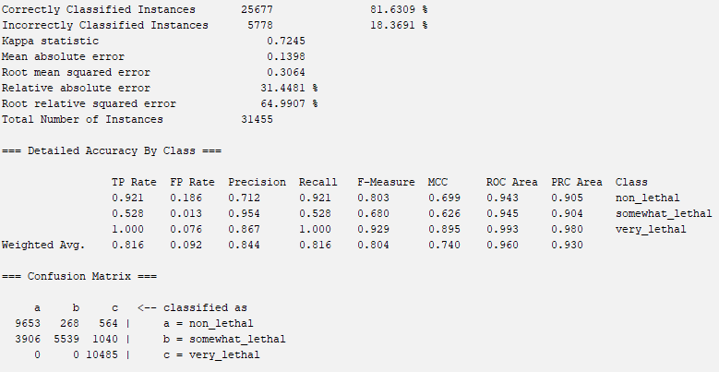
OneRAttributeEval
J48
Naive Bayes

Slide 23
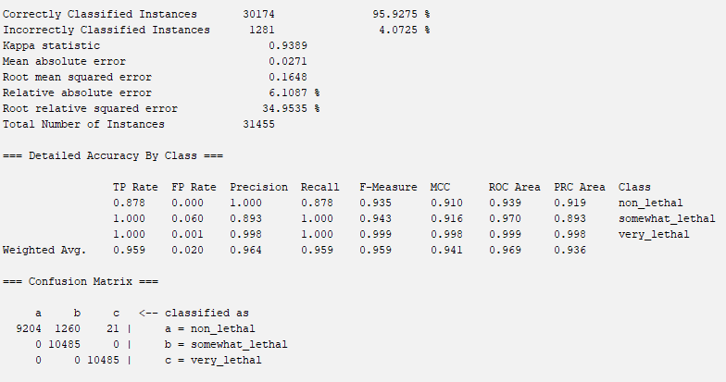
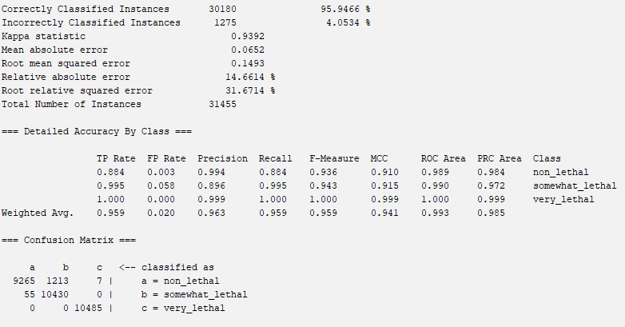
OneRAttributeEval
OneR
Decision Table

Slide 24
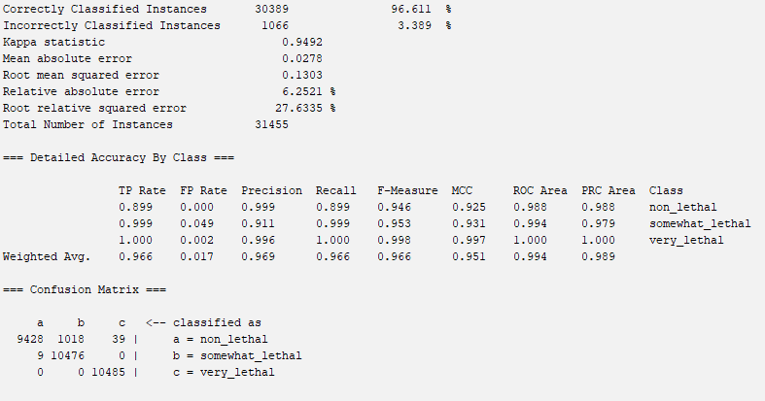
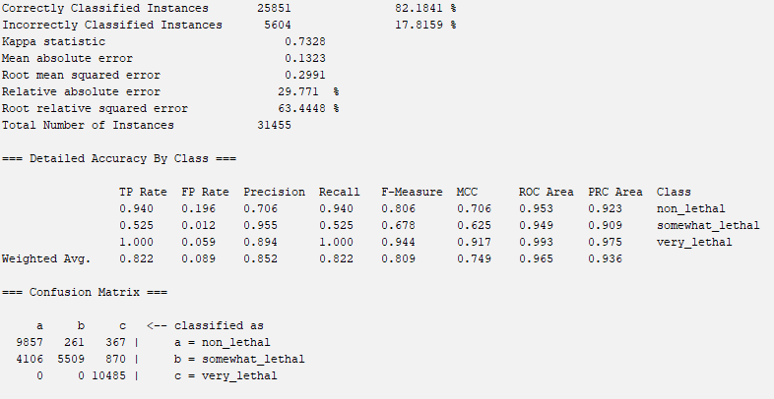
Non-WEKA Approach
J48
Naive Bayes

Slide 25
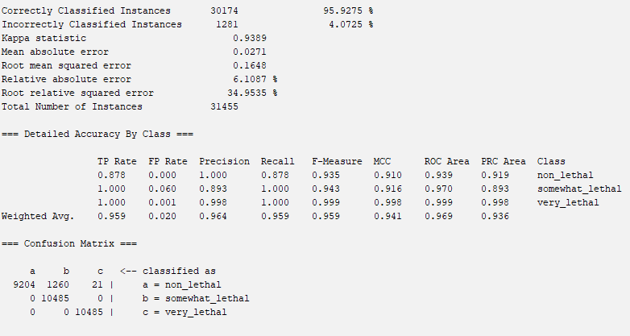
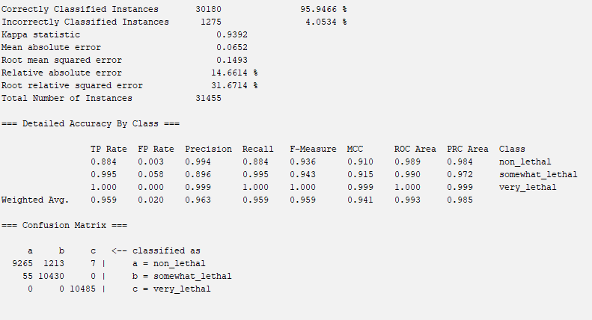
Non-WEKA Approach
OneR
Decision Table

Slide 26
Results and Analysis
Accuracy
 | Gain Ratio | Info Gain | Cfs Subset w/ Greedy Stepwise | OneR | Personal
J48 | 93.51% | 95.11% | 97.27% | 96.52% | 96.61%
Naive Bayes | 67.82% | 79.93% | 49.81% | 81.63% | 82.18%
OneR | 95.93% | 95.93% | 95.93% | 95.93% | 95.93%
Decision Table | 95.36% | 95.36% | 49.81% | 95.95% | 95.95%

Slide 27
Results and Analysis
RMS-Error
 | Gain Ratio | Info Gain | Cfs Subset w/ Greedy Stepwise | OneR | Personal
J48 | 0.162 | 0.138 | 0.125 | 0.132 | 0.130
Naive Bayes | 0.314 | 0.314 | 0.542 | 0.306 | 0.299
OneR | 0.165 | 0.165 | 0.165 | 0.165 | 0.165
Decision Table | 0.156 | 0.156 | 0.542 | 0.149 | 0.149

Slide 28
Results and Analysis
Selected model: CfsSubsetEval with J48
Highest accuracy: CfsSubsetEval with J48 - 0.972691
Lowest root mean squared error: CfsSubsetEval with J48 - 0.1246
Highest TP Rate: CfsSubsetEval with J48 - 0.973
Lowest FP Rate: CfsSubsetEval with J48 - 0.014
Selected Attributes: LATITUDE, LONGITUDE, NUMBER OF CYCLIST INJURED, CONTRIBUTING FACTOR VEHICLE 1

Slide 29
Conclusion and Further Steps
From our analysis above, we concluded that the CfsSubsetEval attribute selection algorithm combined with the J48 classifier model was most accurate in predicting the lethality of car crashes in New York City Boroughs.
In future projects the dataset could be used to focus on specific attributes, such as which streets or boroughs seem to be the most deadly or most prone to car crashes with injuries. Additionally, applying area-specific analyses could provide deeper insights. For example, identifying patterns in high-lethality zones across different boroughs or understanding factors contributing to higher crash rates on particular streets could lead to more targeted interventions, such as better traffic management, road design improvements, or stricter enforcement in high-risk areas.

Slide 30
Sources
“City of New York - Motor Vehicle Collisions - Crashes.” Catalog, Publisher data.cityofnewyork.us, 19 Oct. 2024, catalog.data.gov/dataset/motor-vehicle-collisions-crashes.
Khanna, Nilima. “J48 Classification (C4.5 Algorithm) in a Nutshell.” Medium, Medium, 18 Aug. 2021, medium.com/@nilimakhanna1/j48-classification-c4-5-algorithm-in-a-nutshell-24c50d20658e.
Zhang, Zixuan. “Naive Bayes Explained.” Medium, Towards Data Science, 14 Aug. 2019, towardsdatascience.com/naive-bayes-explained-9d2b96f4a9c0.
Finding the Data & Building Proposal: Aaryan
Preprocessing Initial Attempt: Aaryan
Preprocessing & Project Update: Aaryan
Non-Weka Attribute Selection Algorithm: Sami
Attribute Selection Algorithms and Classifiers: Sami
Results Output: Sami
Results Analysis: Sami
Building Final Report: Aaryan and Sami

